Slide 1
How to find a FMU in a haystack
Screening abstracts en masse

Slide 2
Discussion of how to utilize crossref and ChatGPT to evaluate abstracts

Slide 3
Collect database
Refine search with additional keywords
Evaluate final abstracts manually
Initial screening using broad keywords to bring it down to a manageable size
Evaluate abstracts using ChatGPT

Slide 4
Possible sources of abstracts
Crossref
  https://www.crossref.org/blog/2024-public-data-file-now-available-featuring-new-experimental-formats/
Datacite
Arxiv.org
  https://www.kaggle.com/datasets/Cornell-University/arxiv

Slide 5
Initial reduction - Broad keywords
simulat = {simulating;simulator;simulate}
model = {model;modeling}
~3 million hits
~10h

Slide 6
Refined reduction - specific keywords
simulating
simulator
simulate
model
modeling
intended use
verification
verify
validation
validate
credibility
credible
Each hit gives one point
~1h

Slide 7
Ask ChatGPT 3.5
I'm writing a article on evaluating model credibility and model intended use in the context of simulating complex systems like aircrafts, cars or telecom networks with a focus on verification and validation. How well does this abstract fit into this category, can you estimate the fit in percentage in the format "Abstract fit: %"
{title}, {abstract_text}
~1000 abstracts with highest number of keyword hits evaluated

Slide 8
Iteration 2!
Collect database
Refine search with advanced keyword search
Final evaluation using ChatGPT 4
Initial screening using broad keywords to bring it down to a manageable size
Evaluate final abstracts manually
Rough evaluation using ChatGPT 3.5

Slide 9
Refined keywords - grouping, weights
["simulating", "simulator", "simulate"], weight=1
["model", "modeling"], weight=1
["intended use", "intended-use"], weight=1
["verification", "verify", "validation", "validate"], weight=1
["uncertainty", "uncertainty quantification", "sensitivity analysis", "sensitivity"], weight=1
["complex system"], weight=1
["physics-based simulation"], weight=1
["cyber-physical systems", "cps"], weight=1
["cba", "certification by analysis"], weight=1
["digital twin", "digital shadow"], weight=1
["co-simulation", "cosimulation"], weight=1
["fidelity"], weight=1
["methodology"], weight=0.5
["large-scale simulator", "large-scale simulation"], weight=1
["mbse", "model-based system engineering"], weight=1
["hardware-in-the-loop", "hil", "software-in-the-loop", "sil"], weight=1
["real-time simulators", "rts"], weight=1

Slide 10
Ask ChatGPT 3.5
I'm writing an article on evaluating model credibility and model intended use in the context of large scale simulations, cyber-physical systems and model-based system engineering. A focus is on simulating complex systems like aircrafts, cars or telecom networks. How well does this abstract fit into this category, can you estimate the fit in percentage in the format "Abstract fit: %" and provide a 100 word summary of your motivation
{title}, {abstract_text}
~4000 abstracts with highest number of keyword hits evaluated

Slide 11
Refine using ChatGPT 4
~800 abstracts rated higher than 80% by chat gpt3.5 evaluated

Slide 12
Manual evaluation
Manual evaluation of abstracts rated above 80% by chatgpt 4

Slide 13
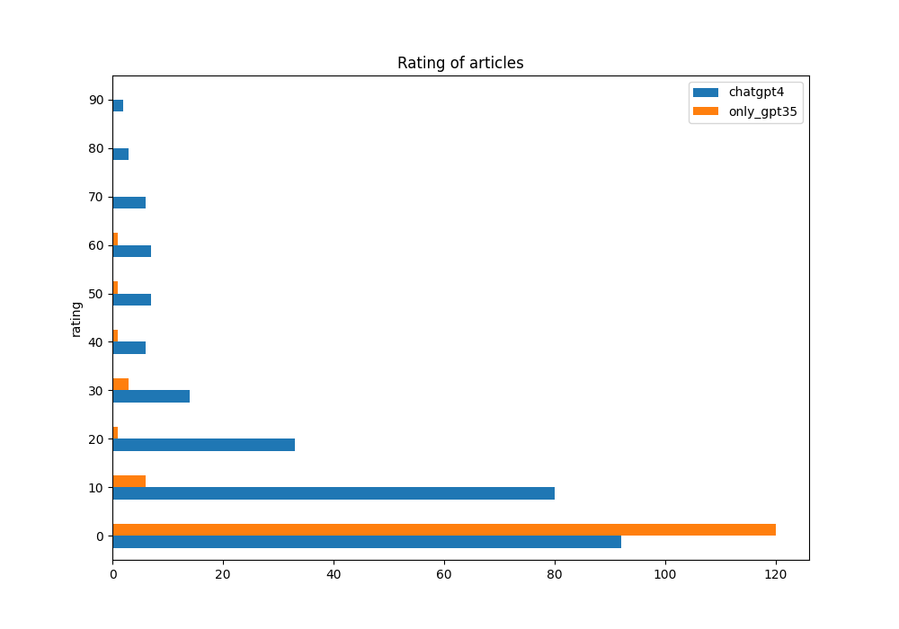
Results
Manual evaluation of
abstracts rated above 80%
by chatgpt 4

Slide 14
Dolor Sit
Evaluation of method

Slide 15
Dolor Sit
Discussion!
Good?
Bad?
Improvements?
Other thoughts

